Slide 1

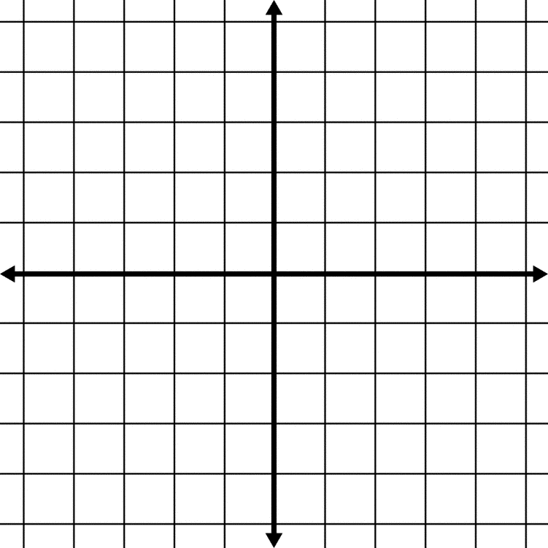
Evaluate f(x)= 5x-3 for x=4
Graph the following point on a graph. *Label Each*
(1, 3), (-1, 0), (1/2, -4), (0, 4)

Slide 2
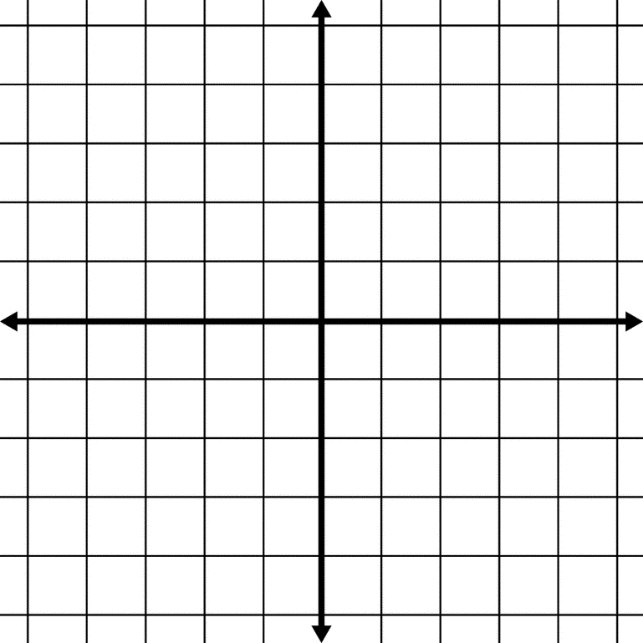


Solve for y: f(x)= 5x-3 for x=4
f(4)= 5(4)-3
f(4)=20-3
f(4)=17
b) Graph the following point on a graph. *Label Each*
(1, 3), (-1, 0), (1/2, -4), (0, 4)
(0, 4)
(1, 3)
(-1, 0)
(1/2, -4)

Slide 3
Relations
Review on Relations and Functions
What is a relationship?
In math a relation is a connection between a set of inputs and a set of outputs

Slide 4
Representations
(other than equations)
1) Ordered pairs:
(-3, -2), (5, 0), (0, 1), (-1, 4), (4, 5), (2, -5)
2) Table:
x | -3 | -1 | 0 | 2 | 4 | 5
y | -2 | 4 | 1 | -5 | 5 | 0

Slide 5
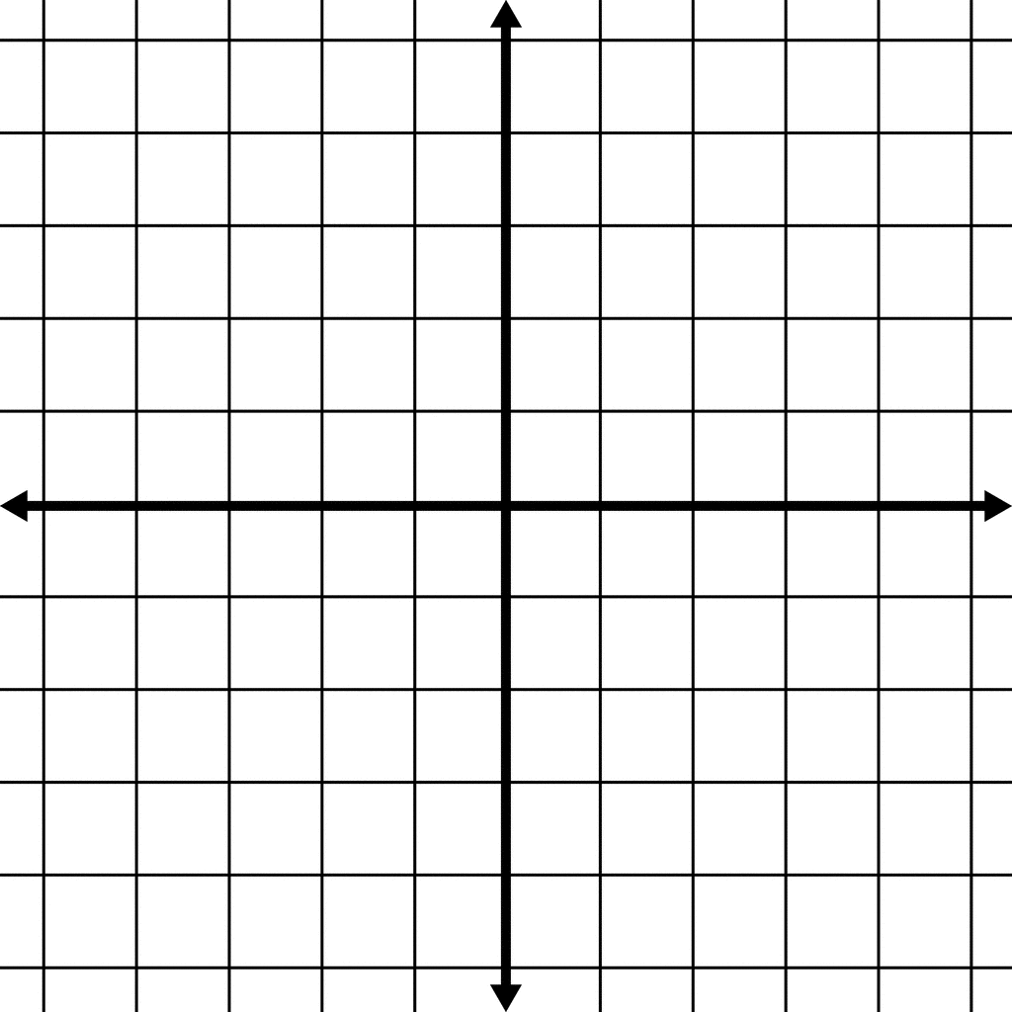
3) Graph
(-3, -2)
(5, 0)
(0, 1)
(-1, 4)
(4, 5)
(2, -5)

Slide 6
4) Mapping
(-3, -2), (5, 0), (0, 1), (-1, 4), (4, 5), (2, -5)
-3
-1
0
2
4
5
-5
-2
0
1
4
5

Slide 7
4) Mapping (another way)
(-3, -2), (5, 0), (0, 1), (-1, 4), (4, 5), (2, -5)
-3
-1
0
2
4
5
-5
-2
0
1
4
5

Slide 8
Domain and Range
Domain- All inputs
Range- All outputs
(-3, -2), (5, 0), (0, 1), (-1, 4), (4, 5), (2, -5)
Domain: -3, 5, 0, -1, 4, -5
Range: -5, -2, 0, 1, 4, 5

Slide 9
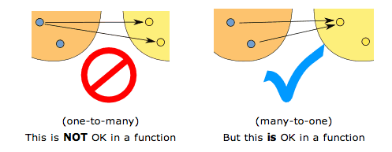
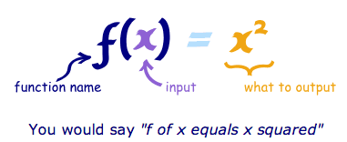
Function
A function is a special kind of relation where every input goes to exactly one output
  It’s PREDICTABLE!
  *Can be written using Function Notation:

Slide 10
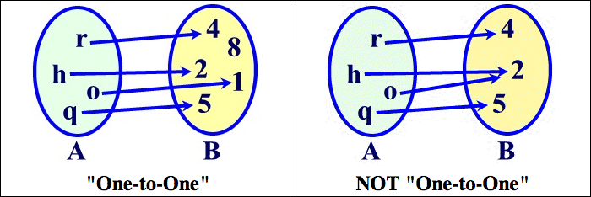
One-to-one
Every input has a unique output

Slide 11
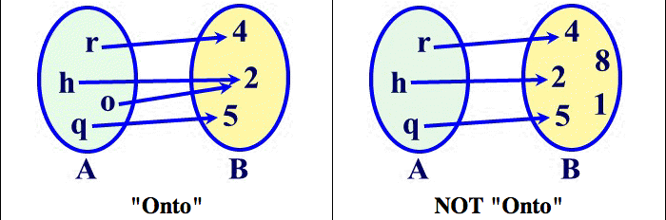
Onto
Every output has an input

Slide 12
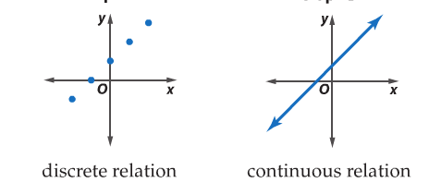
Discrete vs. Continuous
Discrete relation: A relation where the domain is a set of individual points
Continuous relation: A relation that can be graphed with a line or smooth curve

